Slide 1
Playing Breakout
James Eagle, Nathalie Gocht, Simon Karlsson,
Jens Madsen, Pragya Singh

Slide 2
Overview
Implementations
Challenges
Results
Essay

Slide 3
Implementations
the standard DQN implementation, where we fit the model at each step,
a double DQN (one model choosing actions, one for the target Q-values)
a DQN fitting after each episode a larger batch
a A3C implementation

Slide 4
Challenges
A3C implementation:
Tensorflow functions
Local minimum at around 11
Execution time
Debugging

Slide 5
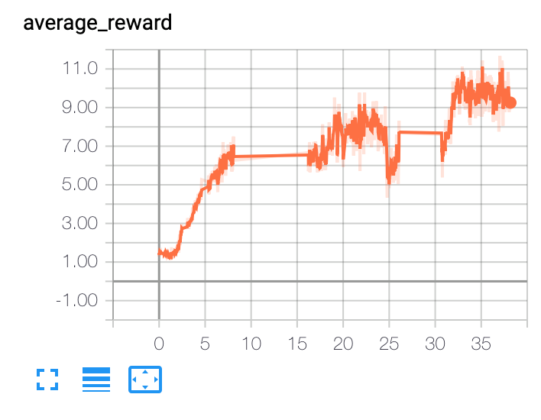
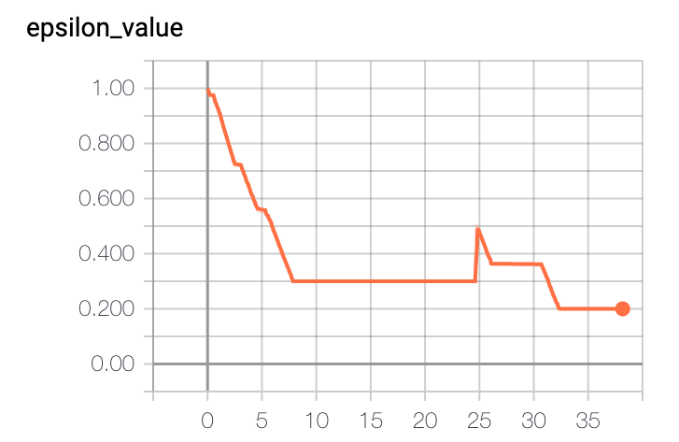
Results
Best implementation: DQN (fit every episode)
Highest average reward: 15

Slide 6

Result

Slide 7
Essay

